Slide 1
ASSIGNMENT
CREATION OF VNET , VIRTUAL MACHINE AND HOSTING WEBSITE ON BROWSER

Slide 2
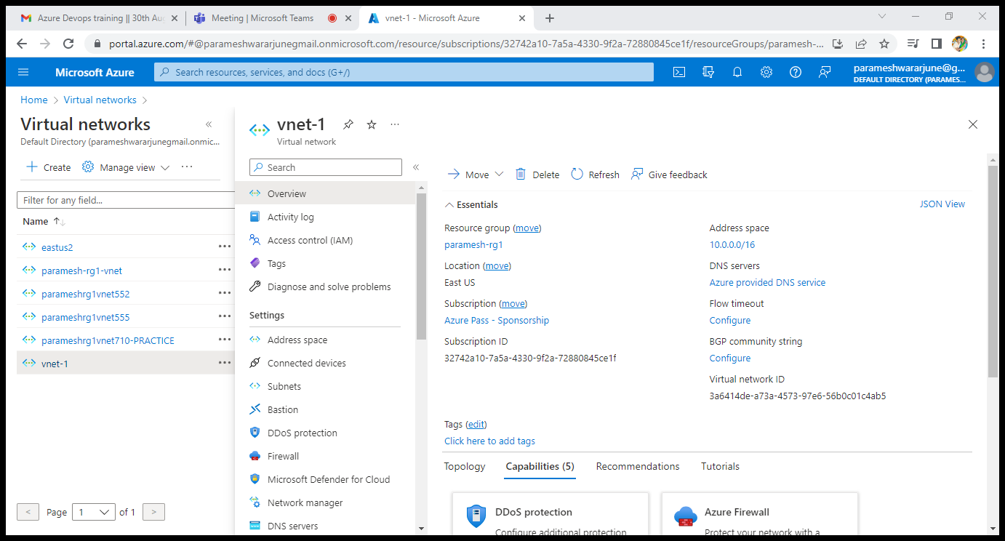
CREATED V NET-WITH IP 2048

Slide 3
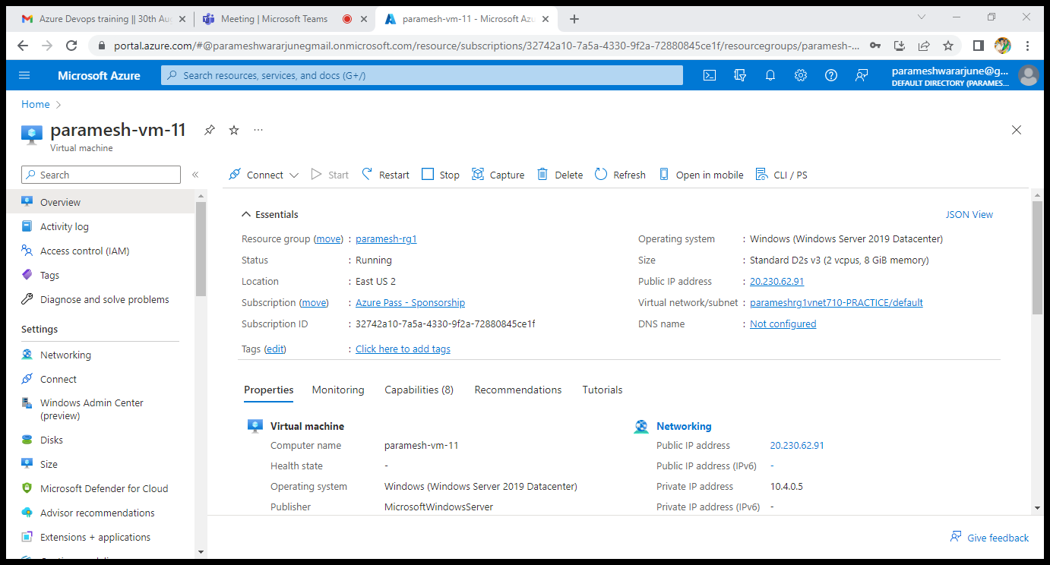
CREATED WINDOWS VIRTUAL MACHINE IN VNET

Slide 4
Connecting to RDP with IP address
Successfully connected to the rdp
Ip address is :-20.230.62.91
Username:-prem
Password :-Paramesh@123PA

Slide 5
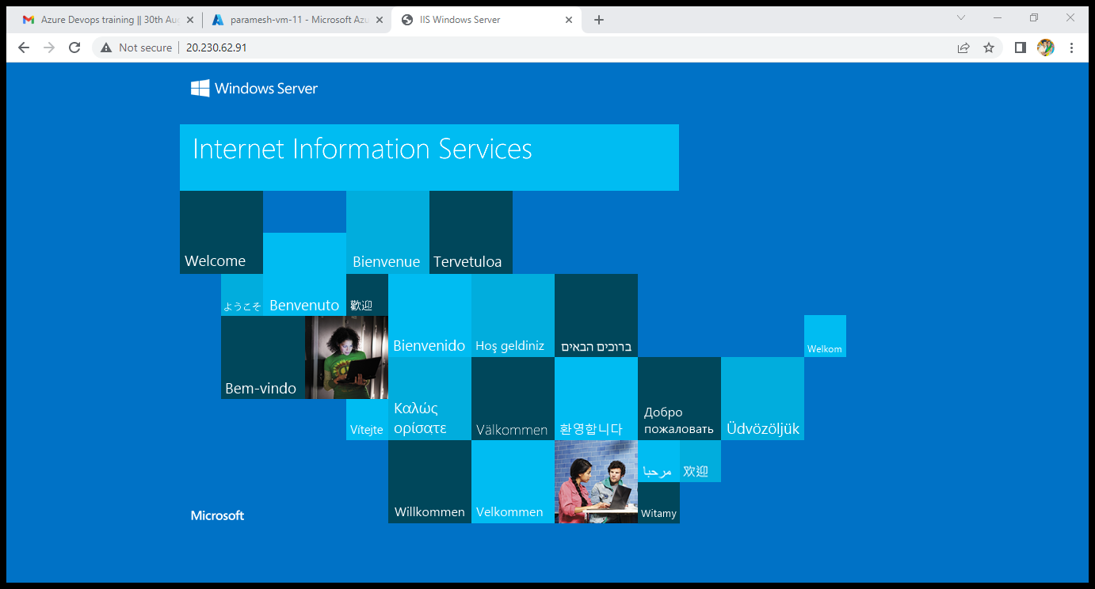

Slide 6
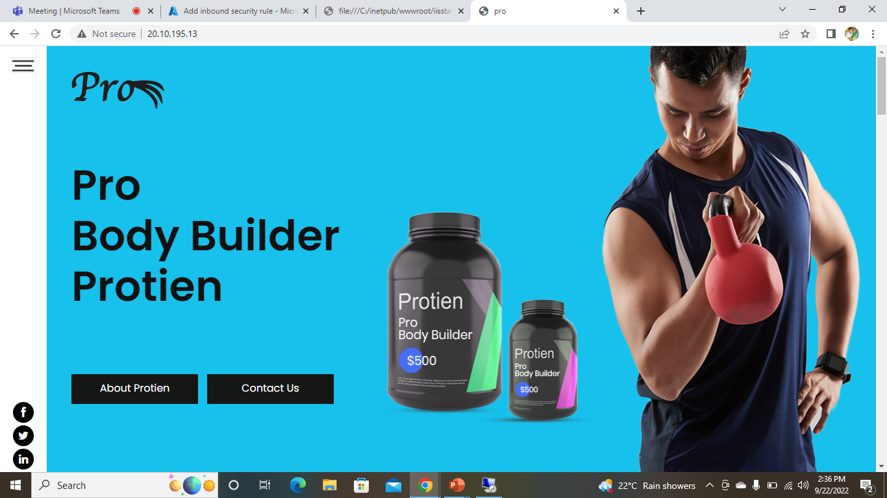
SUCCESSFULLY HOSTED THE WEBSITE IN VM PRO

